Slide 1
Lecture 10: Practical Guide to Tuning Deep Neural Networks – Part 1
Instructor: Yang Xu
Slides inspired by the deeplearning.ai series courses on Coursera.org

Slide 2
Outline
Hyperparameter tuning
Regularization
Optimization

Slide 3
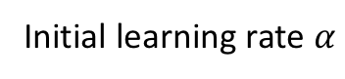
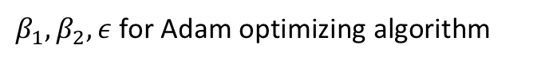
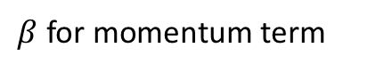
Hyperparameters
More hyperparameters:
Initial learning rate $α$
$β$ for momentum term
# of hidden units
$β_{1},β_{2},ε$ for Adam optimizing algorithm
# of layers
Learning rate decay
Mini-batch size

Slide 4
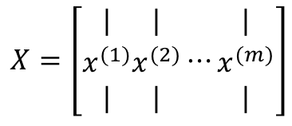
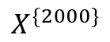
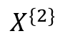
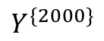
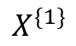
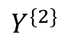
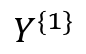
Mini-batch gradient descent
Remember types of gradient descent:
$$X=\left[\begin{matrix}| \\ x^{(1)} \\ |\end{matrix}\begin{matrix}| \\ x^{(2)} \\ |\end{matrix}⋯\begin{matrix}| \\ x^{(m)} \\ |\end{matrix}\right]$$
Batch GD
Minibatch GD
Stochastic GD
Using entire training set (m examples) per iteration
What if m = 2,000,000?
Too costly!
Split the training set into mini-batches of size 1000 each.
$$X=[x^{\left(1\right)},x^{\left(2\right)},⋯,x^{\left(1000\right)}, x^{\left(1001\right)}, ⋯,x^{\left(2000\right)}, ⋯⋯⋯⋯⋯⋯,x^{\left(m−999\right)},⋯,x^{\left(m\right)}]$$
$$X^{\{1\}}$$
$$X^{\{2\}}$$
$$X^{\{2000\}}$$
Resulting in
2000 minibatches
$$Y^{\{1\}}$$
$$Y^{\{2\}}$$
$$Y^{\{2000\}}$$
$$Y=[y^{\left(1\right)},y^{\left(2\right)},⋯,y^{\left(1000\right)}, y^{\left(1001\right)}, ⋯,x^{\left(2000\right)}, ⋯⋯⋯⋯⋯⋯,x^{\left(m−999\right)},⋯,x^{\left(m\right)}]$$

Slide 5
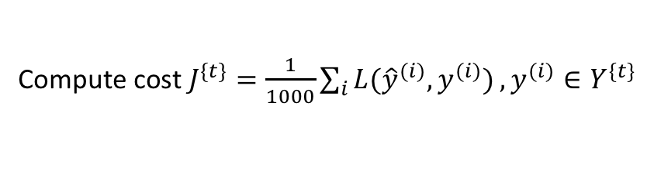
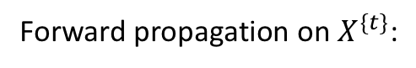
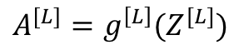
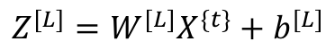
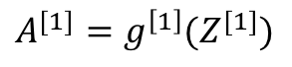
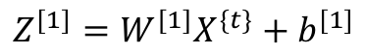
Mini-batch gradient descent for L-layer neural network
for t = 1, 2, …, 2000 {
One pass over the entire data: 1 epoch
Forward propagation on $X^{\{t\}}$:
$$Z^{[1]}=W^{[1]}X^{\{t\}}+b^{[1]}$$
$$A^{[1]}=g^{\left[1\right]}(Z^{[1]})$$
For large data set, mini-batch GD runs much faster than batch GD
Vectorized across
1000 examples
…
$$Z^{[L]}=W^{[L]}X^{\{t\}}+b^{[L]}$$
$$A^{[L]}=g^{\left[L\right]}(Z^{[L]})$$
Compute cost $J^{\{t\}}=\frac{1}{1000}\sum_{i}{L({\hat{y}}^{(i)},y^{(i)})},y^{(i)}∈Y^{\{t\}}$
Compute gradients using $Y^{\{t\}}$ , back propagate and update
}

Slide 6
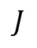
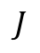
Mini-batch vs. batch vs. stochastic GD
Batch GD
Mini-batch GD
$$J$$
$$J$$
# iter
# mini batch

Slide 7
Choosing mini-batch size
Between 1 and m (total number of examples)
Typical mini-batch size: 64, 128, 256, 512
Faster to access data for CPU/GPU
Make sure that $X^{\{t\}}$ and $Y^{\{t\}}$ are not too big for CPU/GPU memory

Slide 8
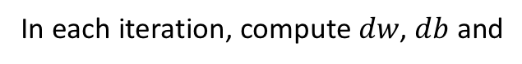
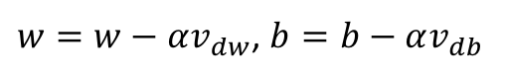
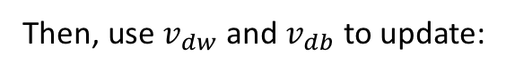
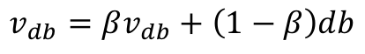
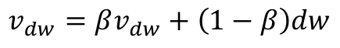
Optimization algorithms faster than gradient descent
Momentum algorithm
Basic idea: compute the exponentially weighted average of gradients, and use this average gradients to update parameters
Momentum:
In each iteration, compute $dw$, $db$ and
$$v_{dw}=βv_{dw}+\left(1−β\right)dw$$
$$v_{db}=βv_{db}+\left(1−β\right)db$$
Then, use $v_{dw}$ and $v_{db}$ to update:
GD: approaching minimum with oscillation
$w=w−αv_{dw}$, $b=b−αv_{db}$
Averaging out the horizontal oscillation

Slide 9
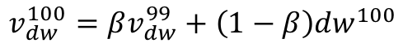
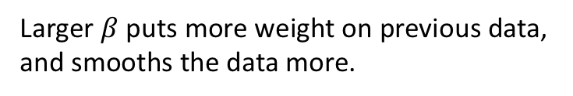
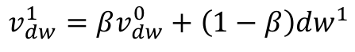
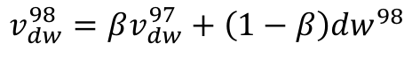
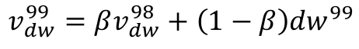
Why is it called exponentially weighted average?
$$v_{dw}^{100}=βv_{dw}^{99}+\left(1−β\right){dw}^{100}$$
$$v_{dw}^{100}=β(βv_{dw}^{98}+\left(1−β\right){dw}^{99})+\left(1−β\right){dw}^{100}$$
$$v_{dw}^{99}=βv_{dw}^{98}+\left(1−β\right){dw}^{99}$$
$$=β(β(βv_{dw}^{97}+\left(1−β\right){dw}^{98})+\left(1−β\right){dw}^{99})+\left(1−β\right){dw}^{100}$$
$$v_{dw}^{98}=βv_{dw}^{97}+\left(1−β\right){dw}^{98}$$
$$=\left(1−β\right){dw}^{100}+β\left(1−β\right){dw}^{99}+β^{2}\left(1−β\right){dw}^{98}+⋯$$
…
$$v_{dw}^{1}=βv_{dw}^{0}+\left(1−β\right){dw}^{1}$$
Exponentially weighted
More weight given to nearer gradient, and less to older
Larger $β$ puts more weight on previous data, and smooths the data more.

Slide 10
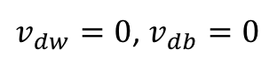
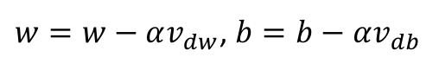
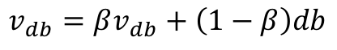
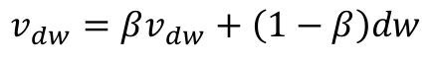
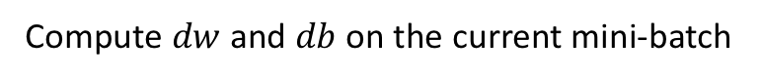
Implementation of momentum
$v_{dw}=0$, $v_{db}=0$
for t in range(num_iters):
Compute $dw$ and $db$ on the current mini-batch
$$v_{dw}=βv_{dw}+\left(1−β\right)dw$$
$$v_{db}=βv_{db}+\left(1−β\right)db$$
$w=w−αv_{dw}$, $b=b−αv_{db}$
$β$ is a hyperparameter that can be tuned. Common choice: $β=0.9$
Momentum almost always works better than vanilla gradient descent

Slide 11
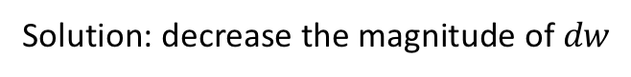
RMSprop algorithm
RMS = root mean square
Similar effect as momentum, different mechanism
w
Assume: there is relatively big oscillation along the direction of $w$
Solution: decrease the magnitude of $dw$
b

Slide 12
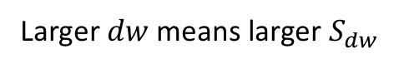
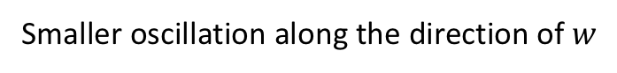
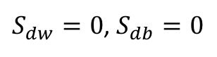
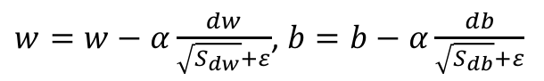
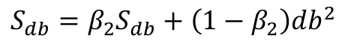
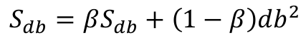
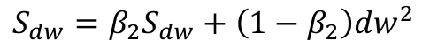
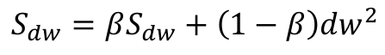
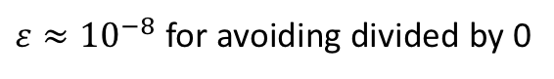
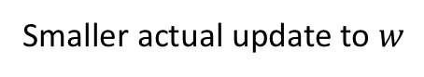
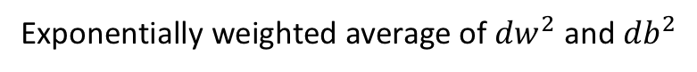
Implementation of RMSprop
$S_{dw}=0$, $S_{db}=0$
for t in range(num_iters):
Compute $dw$ and $db$ on the current mini-batch
To distinguish from momentum
$$S_{dw}=βS_{dw}+\left(1−β\right){dw}^{2}$$
$$S_{dw}=β_{2}S_{dw}+\left(1−β_{2}\right){dw}^{2}$$
$$S_{db}=βS_{db}+\left(1−β\right){db}^{2}$$
$$S_{db}=β_{2}S_{db}+\left(1−β_{2}\right){db}^{2}$$
Exponentially weighted average of ${dw}^{2}$ and ${db}^{2}$
$w=w−α\frac{dw}{\sqrt{S_{dw}}+ε}$, $b=b−α\frac{db}{\sqrt{S_{db}}+ε}$
$ε≈{10}^{−8}$ for avoiding divided by 0
Larger $dw$ means larger $S_{dw}$
Smaller actual update to $w$
Smaller oscillation along the direction of $w$

Slide 13
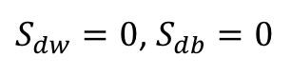
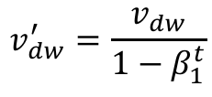
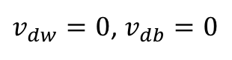
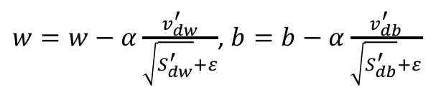
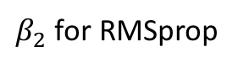









Why not putting momentum and RMSprop together?
Let’s do this! We have Adam (adaptive moment estimation) algorithm
$v_{dw}=0$, $v_{db}=0$
$S_{dw}=0$, $S_{db}=0$
for t in range(num_iters):
Compute $dw$ and $db$ on the current mini-batch
$$v_{dw}=β_{1}v_{dw}+\left(1−β_{1}\right)dw$$
$$S_{dw}=β_{2}S_{dw}+\left(1−β_{2}\right){dw}^{2}$$
$β_{1}$ for momentum
$$v_{db}=β_{1}v_{db}+\left(1−β_{1}\right)db$$
$$S_{db}=β_{2}S_{db}+\left(1−β_{2}\right){db}^{2}$$
$β_{2}$ for RMSprop
$$v_{dw}^{′}=\frac{v_{dw}}{1−β_{1}^{t}}$$
$$S_{dw}^{′}=\frac{S_{dw}}{1−β_{2}^{t}}$$
Bias corrected, to speed up early stage learning
$$v_{db}^{′}=\frac{v_{db}}{1−β_{1}^{t}}$$
$$S_{db}^{′}=\frac{S_{db}}{1−β_{2}^{t}}$$
$w=w−α\frac{v_{dw}^{′}}{\sqrt{S_{dw}^{′}}+ε}$, $b=b−α\frac{v_{db}^{′}}{\sqrt{S_{db}^{′}}+ε}$

Slide 14

Common choice for hyperparameters
$α$ needs to be tuned
$β_{1}=0.9$
$β_{2}=0.999$
$ε={10}^{−8}$

Slide 15

Learning rate decay
Slowly reduce $α$ over time
Helps speed up learning algorithms
Why?
In theory, mini-batch GD will never converge to minimum
Learning rate decay allows to get closer to the minimum

Slide 16






Implementing learning rate decay
A variety of choices
Epoch | $$α$$
1 | 0.025
2 | 0.0167
3 | 0.0125
… | …
$$α_{0}=0.05$$
decay_rate = 1
$$α=\frac{1}{1+\text{decay}\text{_}\text{rate} ∗\text{epoch}\text{_}\text{num}}α_{0}$$
$$α=\frac{k}{\sqrt{\text{epoch}\text{_}\text{num}}}α_{0}$$
$$α=\frac{k}{\sqrt{\text{t}}}α_{0}$$
$$α={0.95}^{\text{epoch}\text{_}\text{num}}α_{0}$$

Slide 17
Next lecture
Regularization of DNN
L2 regularization
Drop-out

